Slide 1

Academic Session 2025-26
ODD Semester Jul-Dec 2025
UNIVERSITY INSTITUTE OF ENGINEERING
COMPUTER SCIENCE ENGINEERING
Bachelor of Engineering
Semester: 6th
Design and Analysis of Algorithms
(23CSH-301/ITH-301)
Unit No. 1 Chapter No. 2 Lecture No. 11
Topic : Heaps
Richa Dhiman E11307 Assistant Professor

Slide 2
1
Learning Objectives & Outcomes
Objective:
To understand the Heap and its types.
To understand heapsort
Outcome:
Student will understand
Heap and its types
Heap sort

Slide 3
2
Heap
A Heap is a special Tree-based data structure in which the tree is a complete binary tree. Generally, Heaps can be of two types:
Max-Heap: In a Max-Heap the key present at the root node must be greatest among the keys present at all of it’s children. The same property must be recursively true for all sub-trees in that Binary Tree.
Min-Heap: In a Min-Heap the key present at the root node must be minimum among the keys present at all of it’s children. The same property must be recursively true for all sub-trees in that Binary Tree.

Slide 4
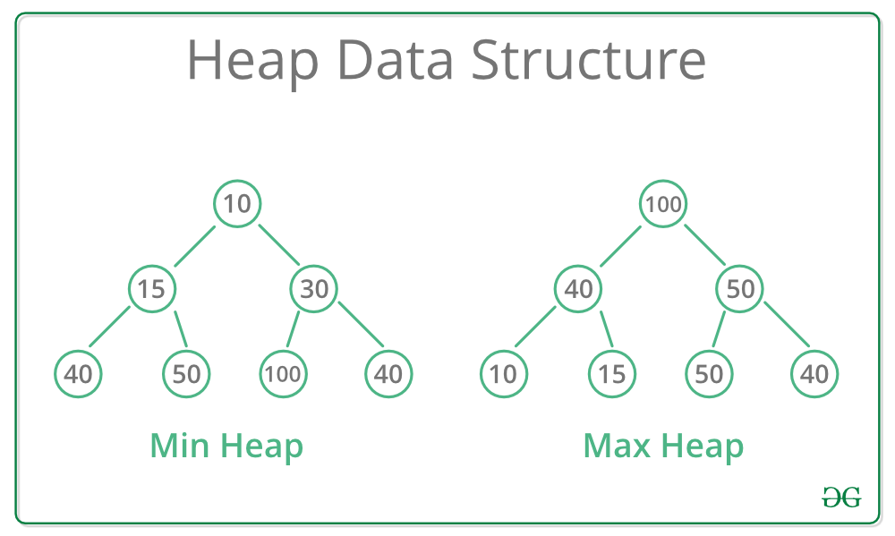
3

Slide 5
4
Methods or Operations of Heap
find - find an item in a heap.
insert - add an item in a heap ensuring the heap property is maintained min-heap and max-heap property.
delete - remove an item in a heap.
extract - return the value of an item and then delete from heap.
replace - extract or pop the root and insert or push a new item in a heap ensuring the heap property has maintained min-heap and max-heap property.

Slide 6
5
Methods or Operations of Heap (Contd..)
Apart from the above mentioned basic operations, there are other operations such as:
size - returns the size of heap.
is-empty - returns 'true' if heap is empty or 'false' if it has value.
merge - joining or union of two heaps, all the values from both heaps are included but the original heaps are preserved.
meld - joining of two heaps where the values from both heaps are included but the original heaps are destroyed.

Slide 7
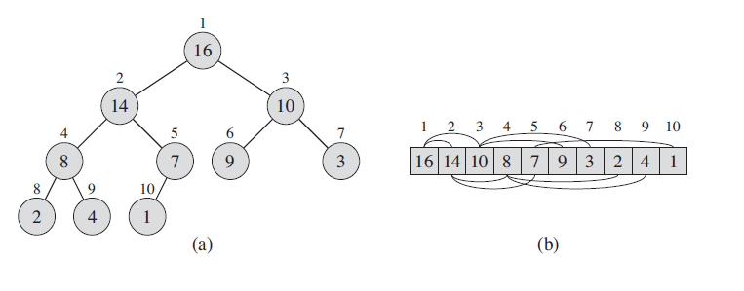
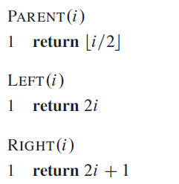
Max-Heap & Array Representation
6

Slide 8
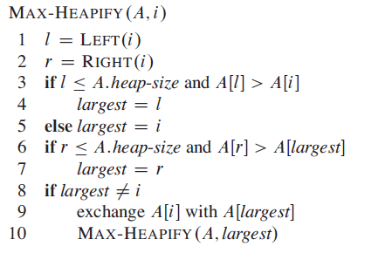
5
Maintaining the heap property

Slide 9
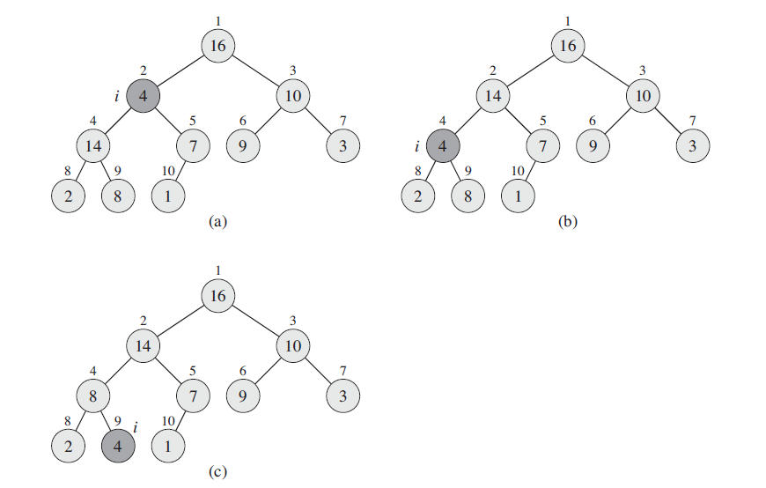
5
Example of maintaining Max Heap:

Slide 10
5
Maintaining the heap property

Slide 11
5
Example of maintaining Max Heap:

Slide 12
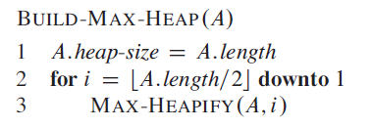
5
Building a heap

Slide 13
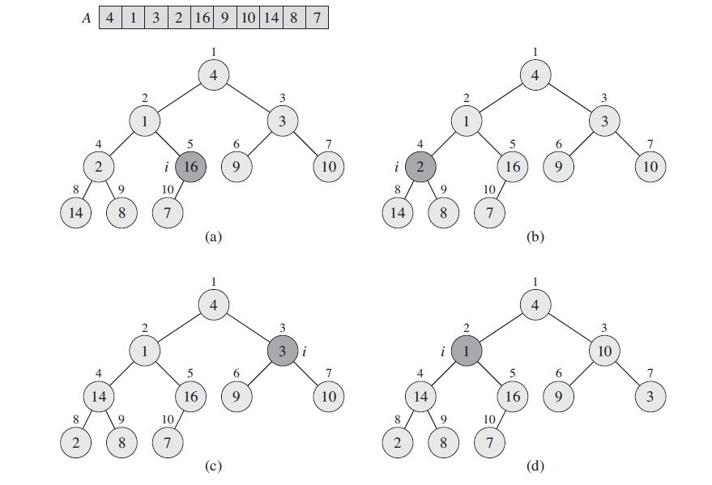
7
Example of Building Max Heap

Slide 14
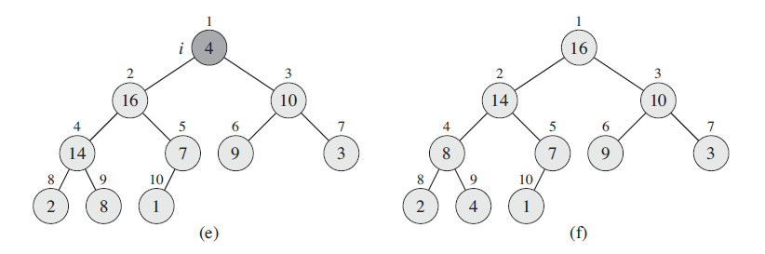
7
Example of Building Max Heap (Contd..)

Slide 15
7
Heap Sort
Heaps can be used in sorting an array. In max-heaps, maximum element will always be at the root. Heap Sort uses this property of heap to sort the array.
Consider an array Arr which is to be sorted using Heap Sort.
Initially build a max heap of elements in Arr.
The root element, that is Arr[1], will contain maximum element of Arr. After that, swap this element with the last element of Arr and heapify the max heap excluding the last element which is already in its correct position and then decrease the length of heap by one.
Repeat the step 2, until all the elements are in their correct position

Slide 16
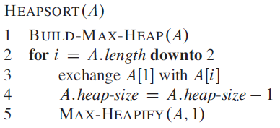
7
Heap Sort Algorithm

Slide 17
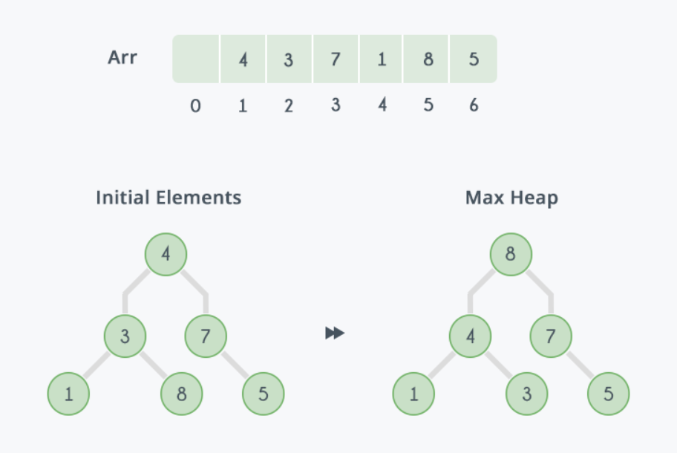
7
Example:
In the diagram below, initially there is an unsorted array Arr having 6 elements and then max-heap will be built.

Slide 18
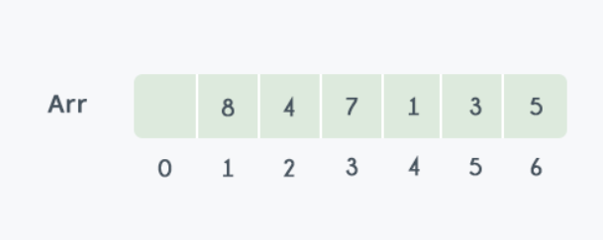
7
Example (Contd.)
After building max-heap, the elements in the array Arr will be:

Slide 19
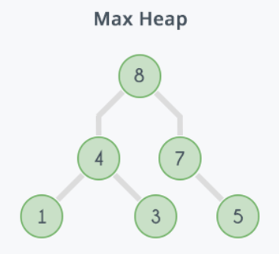
7
Step 1: 8 is swapped with 5. Step 2: 8 is disconnected from heap as 8 is in correct position now and. Step 3: Max-heap is created and 7 is swapped with 3. Step 4: 7 is disconnected from heap. Step 5: Max heap is created and 5 is swapped with 1. Step 6: 5 is disconnected from heap. Step 7: Max heap is created and 4 is swapped with 3. Step 8: 4 is disconnected from heap. Step 9: Max heap is created and 3 is swapped with 1. Step 10: 3 is disconnected.

Slide 20
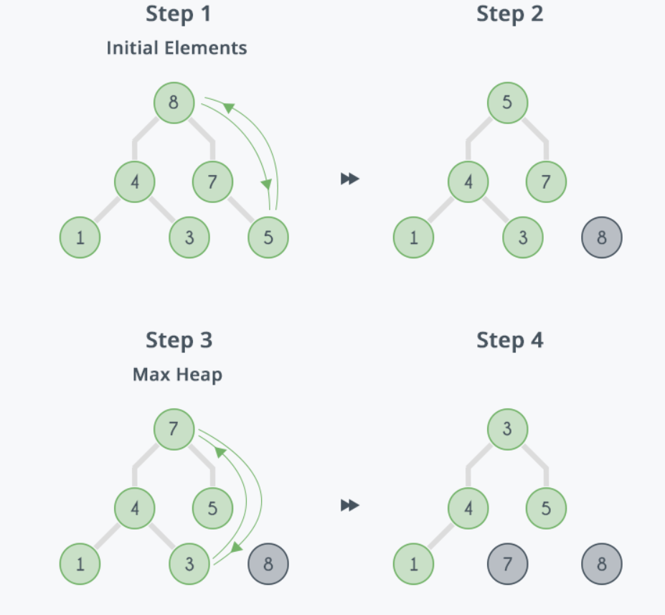
7

Slide 21
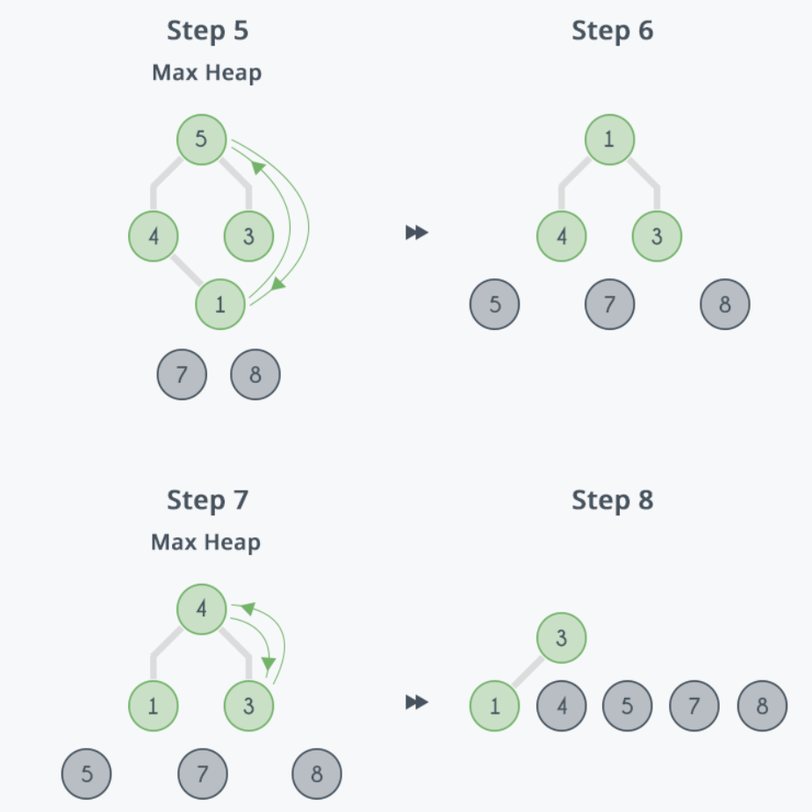
7

Slide 22
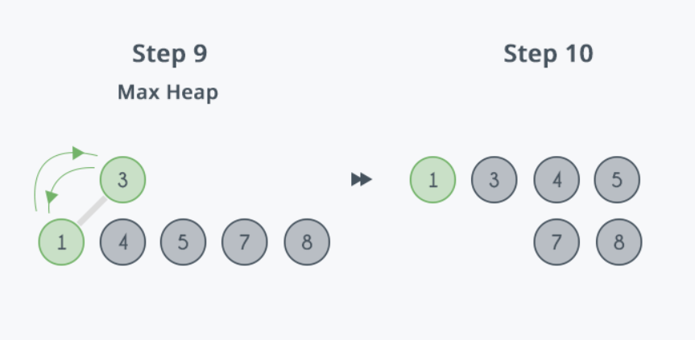
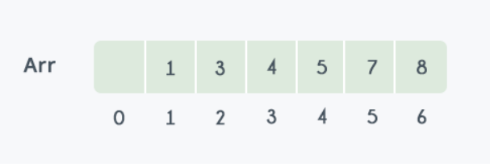
7
After all the steps, we will get a sorted array.

Slide 23
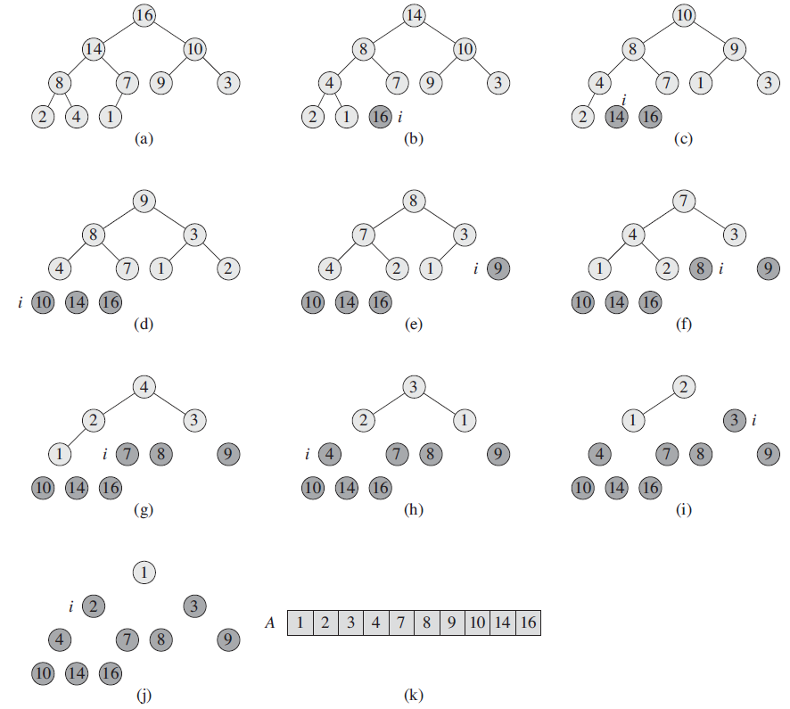
7

Slide 24
Applications
7
Job Scheduling Systems
Bandwidth Management
CPU Task Scheduling
Memory Management (Garbage Collection)
Event-Driven Simulations

Slide 25
Summary
17
Introduction to Heaps
Basic terms
Types of Heaps
Max-heap
Min-heap
Heap Sort

Slide 26
18
Next Lecture
Graphs

Slide 27
19
Quiz
What is the time complexity of inserting an element into a binary heap of size n? A) O(1) B) O(log n) C) O(n) D) O(n log n)
Which data structure is most commonly used to implement a binary heap? A) Linked list B) Array C) Hash table D) Binary search tree

Slide 28
20
References/ Articles/ Videos
Text books:
Cormen, Leiserson, Rivest, Stein, “Introduction to Algorithms”, Prentice Hall of India, 3rd edition 2012. problem, Graph coloring.
Horowitz, Sahni and Rajasekaran, “Fundamentals of ComputerAlgorithms”, University Press (India), 2nd edition
Websites:
https://www.tutorialspoint.com/data_structures_algorithms/heap_data_structure.htm
https://www.geeksforgeeks.org/

Slide 29
21
Faculty-curated videos, NPTEL, Coursera, LinkedIn, or other relevant learning resources
https://onlinecourses.nptel.ac.in/noc23_cs96/preview
https://nptel.ac.in/courses/106106131
https://nptel.ac.in/courses/106106208
https://www.linkedin.com/learning/learning-algorithms

Slide 30
23
Class-Wise Feedback

Slide 31
24
Thank You
For queries
Email: richa.e11307@cumail.in

